Slide 1





A beautiful sunset doing things that don’t matter. . .

Slide 2





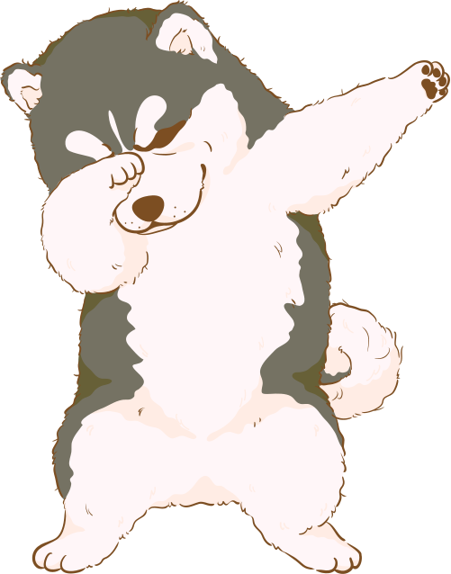


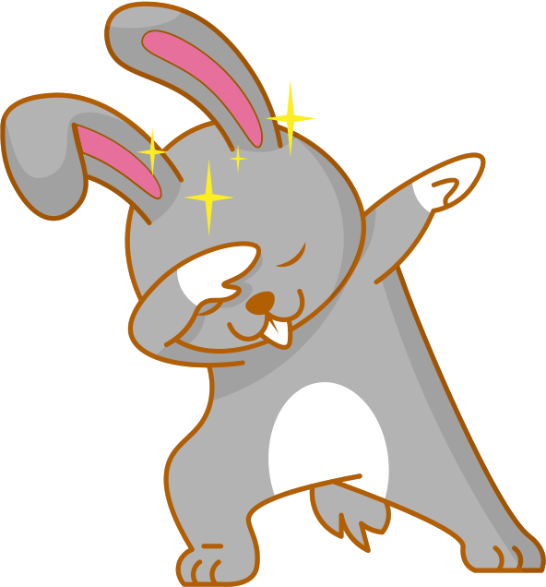



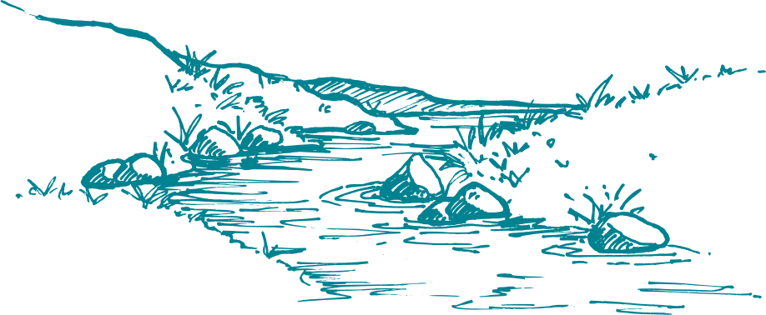
Drag and drop the elements of your choice on the table.
Choose Your Animal

Slide 3
A girl blowing bubbles against a backdrop of a beautiful sunset.

